Slide 1

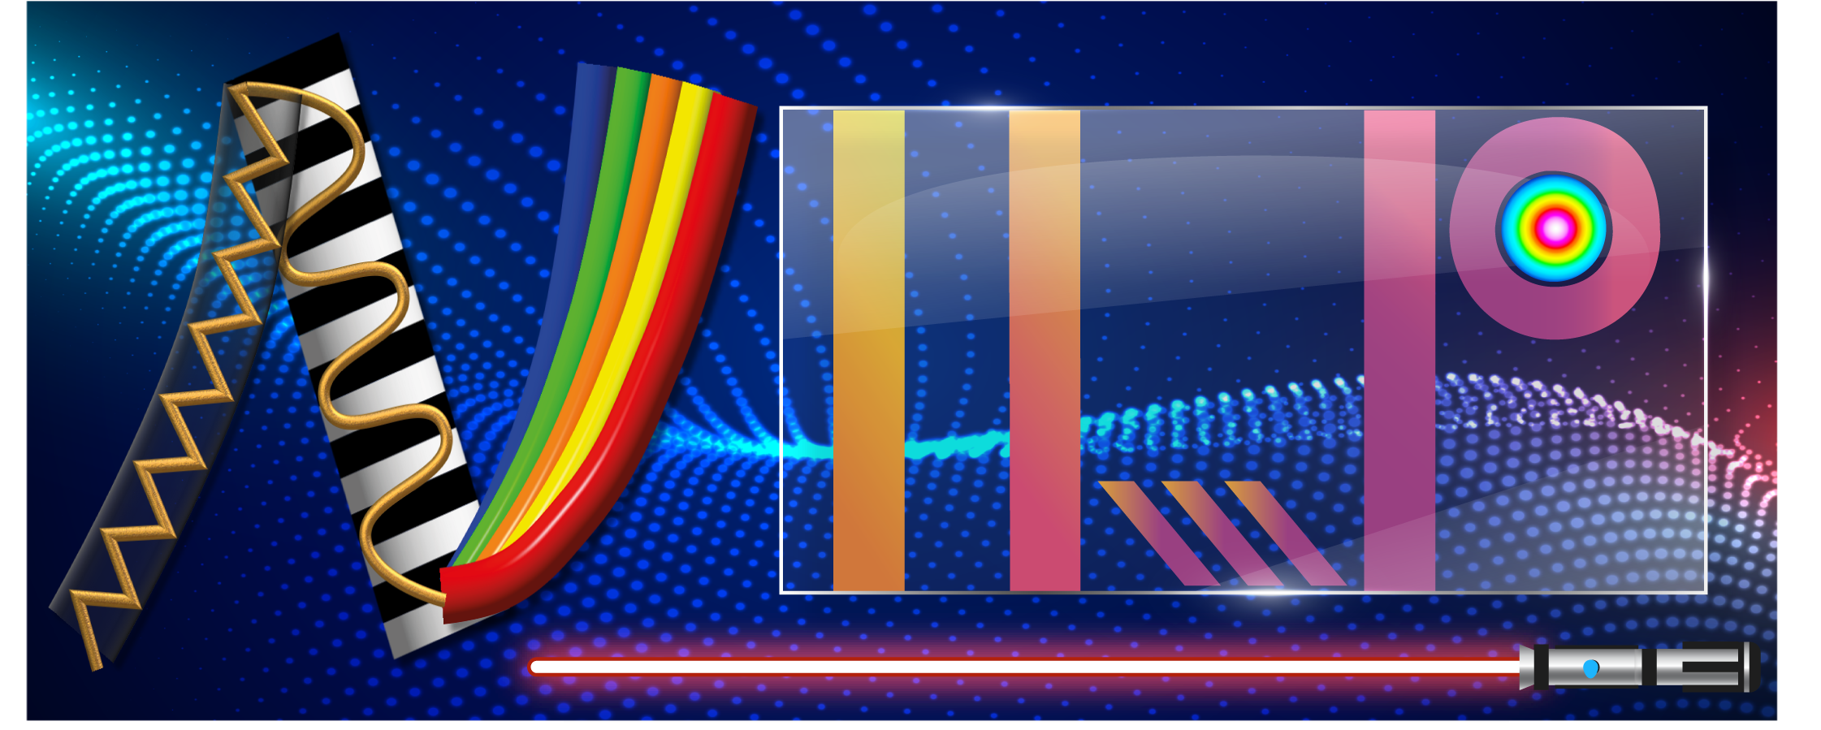

以積體鈮酸鋰波導光參量放大器及絕熱耦合分光器達成晶片型量子壓縮光源之研究
On-chip quantum squeezer based on integrated lithium niobate waveguide optical parametric amplifier and adiabatic beam splitter
學生: 高梃澄
指導教授: 陳彥宏 博士
Nonlinear Integrated Laser Photonics Lab (NILP), Department of Optics and Photonics, National Central University, Jhongli 320, Taiwan
Notes:
各位口試委員，午安，大家好，我是高梃澄，今天我要報告的題目是…，

Slide 2
Introduction
Theory
Quantum state
Balance homodyne detection(BHD)
Sum frequency generation(SFG)/Optical parametric amplifier(OPA)
Quasi-phase matching(QPM)
Stimulated Raman adiabatic passage(STIRAP)
Simulation
Adiabatic beam splitter design
High-pass filter simulation
Fabrication process
Ti-indiffused waveguide
Electric field poling
End face polish
Experimental Results and Analysis
Propagation loss
ER spectrum
SHG characteristic
Squeezing light optical setup
Conclusion and future work
Notes:
Outline順過
在各部分在介紹為何這樣編排

Slide 3
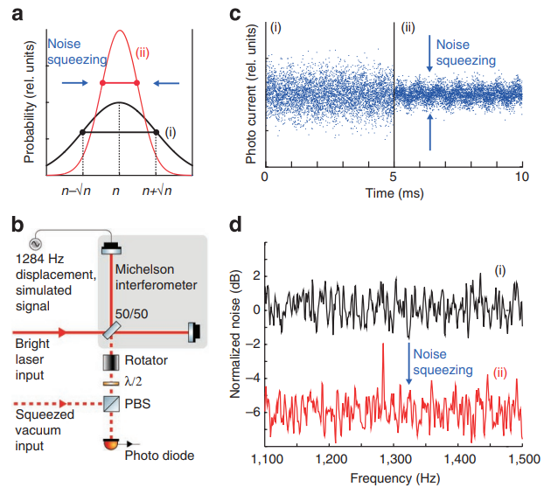
Introduction
Roman Schnabel et al, Nature Communications, 1(20210)
Notes:
壓縮光是非古典的光在某個正交項會比一般古典光的雜訊還要低，根據海森堡不確定性原理，相干態的雜訊定義出標準量子雜訊，透過壓縮光特性可以超過這個量子極限，以提高感測上的精準度
a.(i)shot-noise(ii)squeezed noise表示壓縮光的光子數統計下小於shot-noise
b.透過Michelson干涉儀將一般雷射和壓縮光做干涉，能夠提升訊雜比
比較1284Hz調制訊號，沒壓縮光參與看不到訊號，可以在c.光電流圖d.雜訊頻譜圖

Slide 4
Motivation
In CW scheme | OPO(cavity) | OPA(waveguide)
Squeezing level | 15dB[1] | 6dB[2]
Bandwidth | ~GHz | ~THz
volume | large | small
Pumping source | Pulse | CW
Squeezing level | large | small
Damage effect | Gain-induced diffraction | Photorefractive
Mode match | Temporal mode mismatching | x
Integrated quantum light source chip, compact and stable:
OPA high bandwidth enhance quantum computation
AC fabrication tolerant and broadband
[1]Henning Vahlbruch et al, Phys. Rev. Lett. 117(2016)
[2]Takahiro Kashiwazaki et al, APL Photonics 5, 036104 (2020)
Notes:
進步性跟其他研究

Slide 5
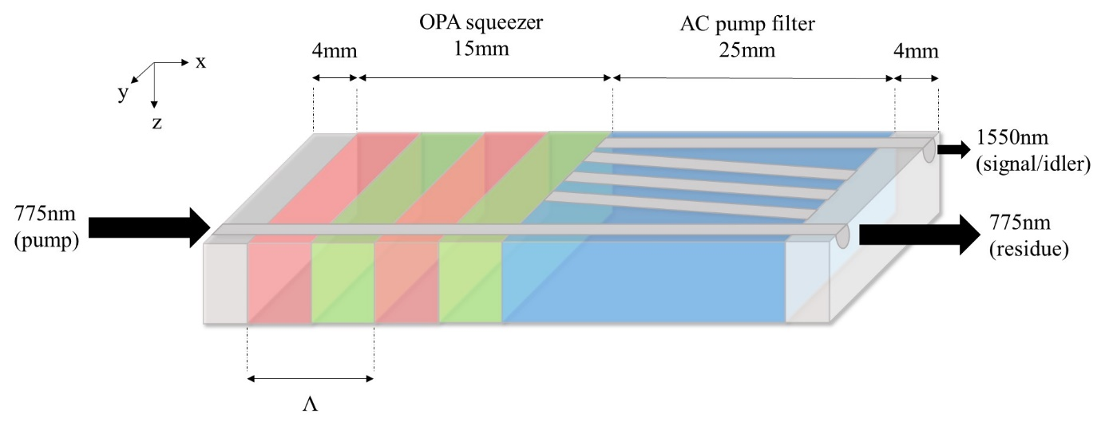
Chip design
Notes:
晶片是使用type-0 OPA方式將真空態轉成真空壓縮態
後面接一段絕熱耦和分光器將pump 775nm和signal 1550nm分開
完成積體化晶片型量子壓縮光源

Slide 6
Introduction
Theory
Quantum state
Balance homodyne detection(BHD)
Sum frequency generation(SFG)/Optical parametric amplifier(OPA)
Quasi-phase matching(QPM)
Stimulated Raman adiabatic passage(STIRAP)
Simulation
Adiabatic beam splitter design
High-pass filter simulation
Fabrication process
Ti-indiffused waveguide
Electric field poling
End face polish
Experimental Results and Analysis
Propagation loss
ER spectrum
SHG characteristic
Squeezing light optical setup
Conclusion and future work

Slide 7
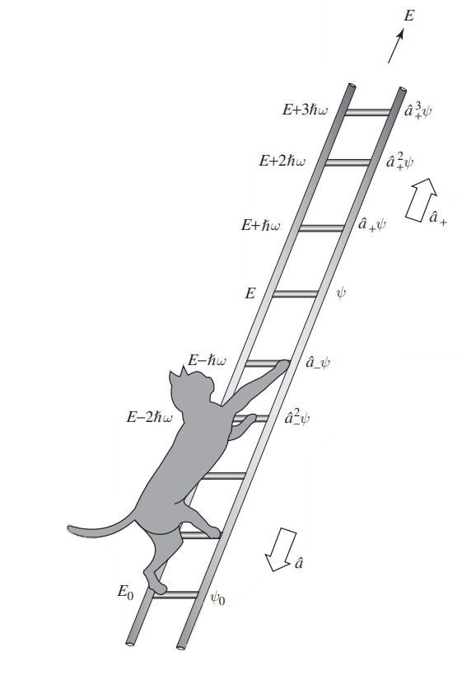
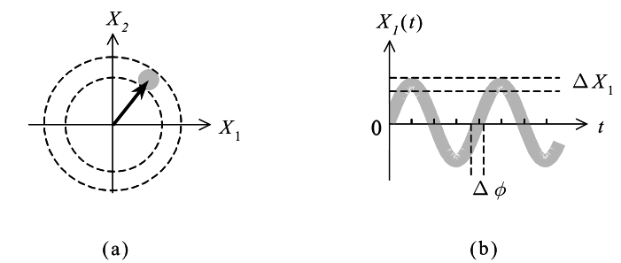
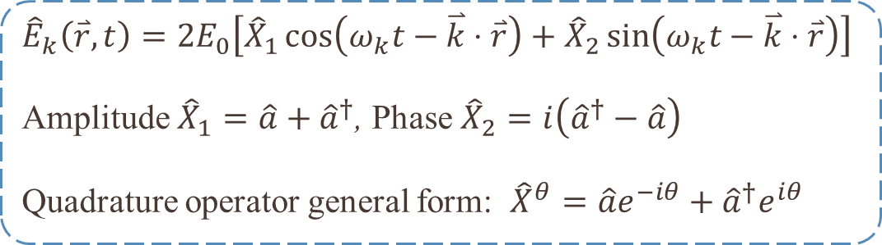
Quantum state
${\hat{E}}_{k}\left(\overset{⃑}{r},t\right)=2E_{0}\left[{\hat{X}}_{1}\cos\left(ω_{k}t−\overset{⃑}{k}⋅\overset{⃑}{r}\right)+{\hat{X}}_{2}\sin\left(ω_{k}t−\overset{⃑}{k}⋅\overset{⃑}{r}\right)\right]$
Amplitude ${\hat{X}}_{1}=\hat{a}+{\hat{a}}^{†}$, Phase ${\hat{X}}_{2}=i\left({\hat{a}}^{†}−\hat{a}\right)$
Quadrature operator general form: ${\hat{X}}^{θ}=\hat{a}e^{−iθ}+{\hat{a}}^{†}e^{iθ}$
D. J. Griffiths and D. F. Schroeter, Introduction to Quantum Mechanics, Third edition ed. Cambridge University Press(2018)
Notes:
量子化光場
正交算符由上升合下降算符表示為
零點能量對應到vacuum state
相位圖、time domain上量測可以看到隨著干涉的相位差改變而出現建設性和破壞性的干涉現象

Slide 8
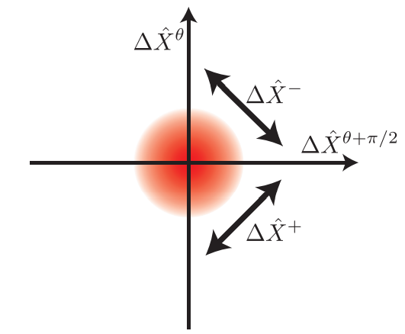
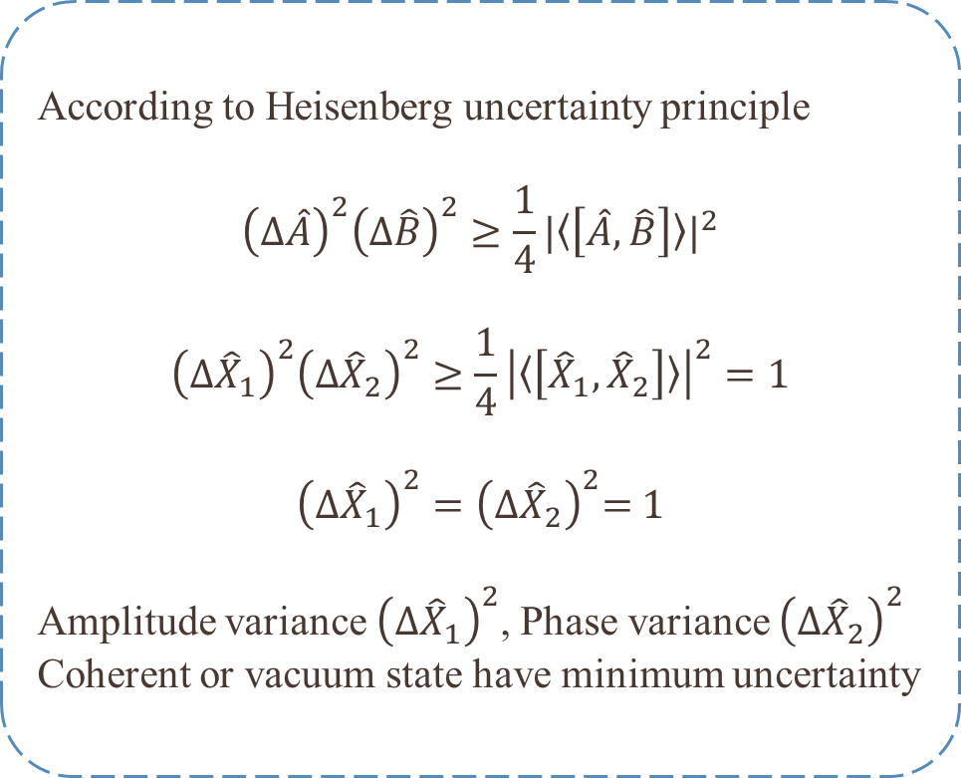
Vacuum state
According to Heisenberg uncertainty principle
$${\left(Δ\hat{A}\right)}^{2}{\left(Δ\hat{B}\right)}^{2}≥\frac{1}{4}{|〈\left[\hat{A},\hat{B}\right]〉|}^{2}$$
$${\left(Δ{\hat{X}}_{1}\right)}^{2}{\left(Δ{\hat{X}}_{2}\right)}^{2}≥\frac{1}{4}{\left|〈\left[{\hat{X}}_{1},{\hat{X}}_{2}\right]〉\right|}^{2}=1$$
$${\left(Δ{\hat{X}}_{1}\right)}^{2}={\left(Δ{\hat{X}}_{2}\right)}^{2}\text{= }\text{1}$$
Amplitude variance ${\left(Δ{\hat{X}}_{1}\right)}^{2}$, Phase variance ${\left(Δ{\hat{X}}_{2}\right)}^{2}$
Coherent or vacuum state have minimum uncertainty
Vacuum state
G. L. Mansell,"Squeezed light sources for current and future interferometric gravitational-wave detectors",PhD thesis,Australian National University(2018)
Notes:
量子態中最基本的是真空態
海森堡不確定性原理，得到兩個正交態的變異數的乘積最小為1
振幅和相位皆為1，對應到的正是相干態或是真空態的正交算符變異數如左圖

Slide 9
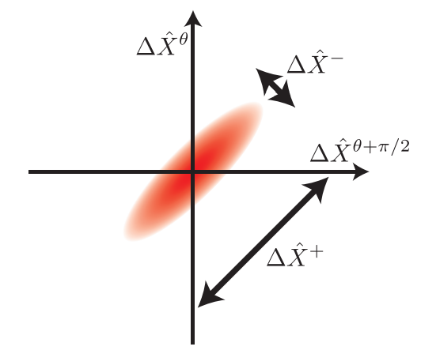
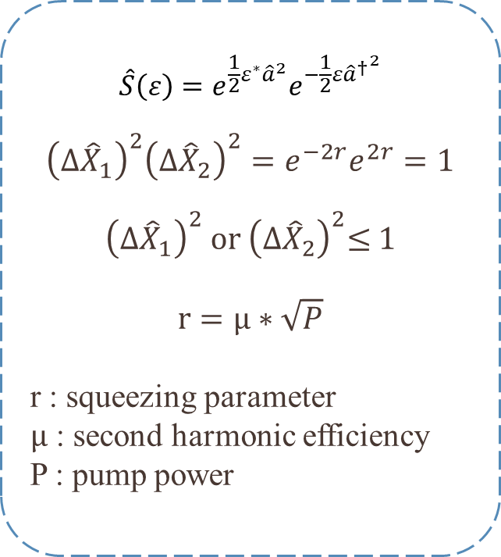
Squeezed vacuum state
$$\hat{S}\left(ε\right)=e^{\frac{1}{2}ε^{∗}{\hat{a}}^{2}}e^{−\frac{1}{2}ε{{\hat{a}}^{†}}^{2}}$$
$${\left(Δ{\hat{X}}_{1}\right)}^{2}{\left(Δ{\hat{X}}_{2}\right)}^{2}=e^{−2r}e^{2r}=1$$
$${\left(Δ{\hat{X}}_{1}\right)}^{2} or {\left(Δ{\hat{X}}_{2}\right)}^{2}\text{≤ 1}$$
$$r=μ∗\sqrt{P}$$
r : squeezing parameter
$μ$ : second harmonic efficiency
P : pump power
Squeezed vacuum state
G. L. Mansell,"Squeezed light sources for current and future interferometric gravitational-wave detectors",PhD thesis,Australian National University(2018)
Notes:
從不確定原理中可以預測出是不是有個量子態可以達到在某一個正交態小於1而另一部份大於1，這個量子態就是壓縮態
左圖是真空壓縮態
右邊變異數的成績依舊為1，其中的r 稱作壓縮參數，和倍頻轉換效率、pump能量有關

Slide 10
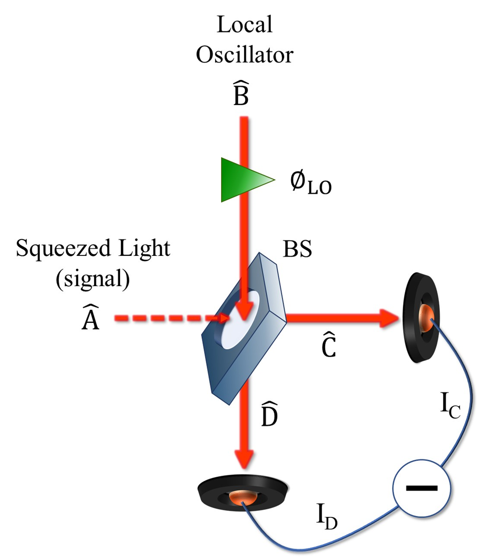
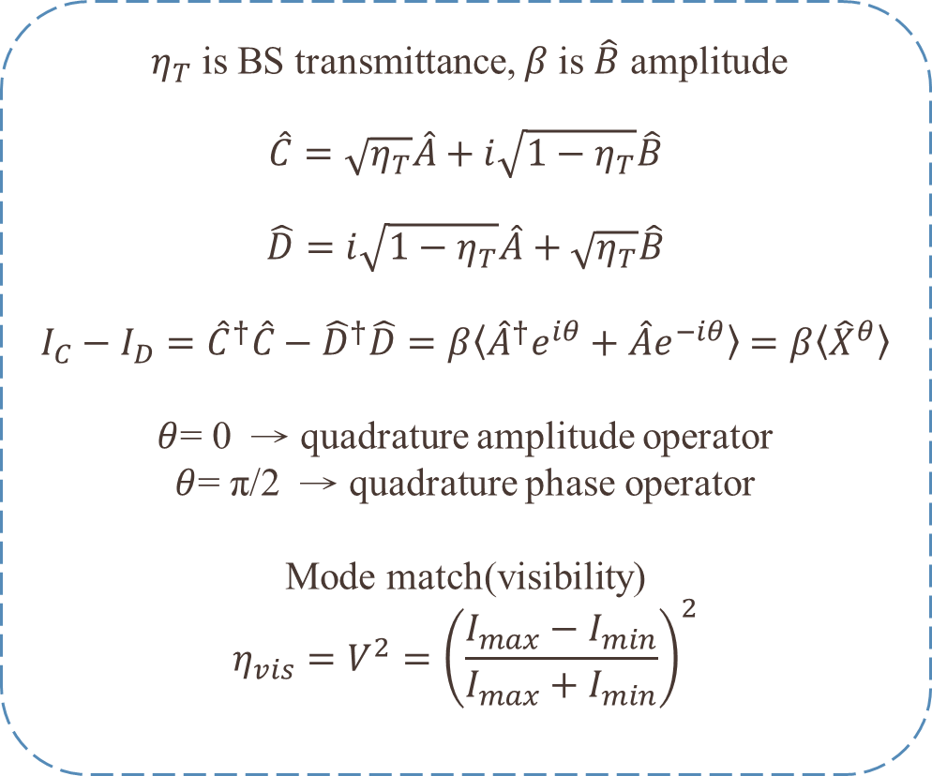
Balance homodyne detection(BHD)
$η_{T}$is BS transmittance, $β$is $\hat{B}$ amplitude
$$\hat{C}=\sqrt{η_{T}}\hat{A}+i\sqrt{1−η_{T}}\hat{B}$$
$$\hat{D}=i\sqrt{1−η_{T}}\hat{A}+\sqrt{η_{T}}\hat{B}$$
$I_{C}−I_{D}={\hat{C}}^{†}\hat{C}−{\hat{D}}^{†}\hat{D}=β〈{\hat{A}}^{†}e^{iθ}+\hat{A}e^{−iθ}〉$ $=β〈{\hat{X}}^{θ}〉$
$θ$= 0 → quadrature amplitude operator
$θ$= π/2 → quadrature phase operator
Mode match(visibility)
$$η_{vis}=V^{2}={\left(\frac{I_{max}−I_{min}}{I_{max}+I_{min}}\right)}^{2}$$
Notes:
量測真空壓縮光的方法是利用干涉的技術將coherent state、squeezed vacuum state干涉，並將兩道干涉光經由光偵測器後相減，稱作BHD
能夠將壓縮光微量的雜訊擾動透過本地振盪器(Local Oscillator)放大
推導中 透過BHD技術可以量測任意的正交項變異數
Visibility描述的是兩道光的重合程度，重合度愈高代表LO可以有效地去放大壓縮光正交算符的變異數並偵測

Slide 11
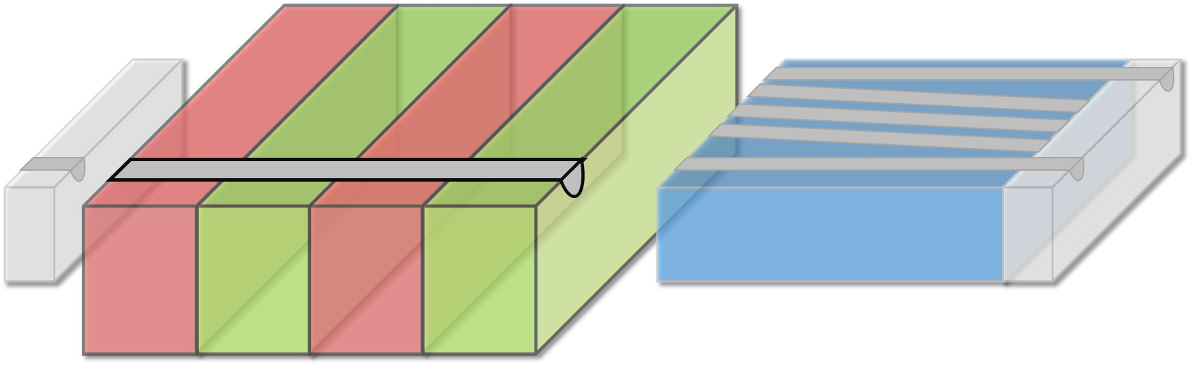
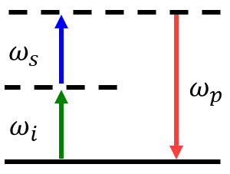
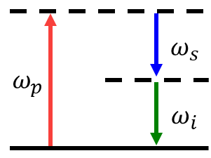











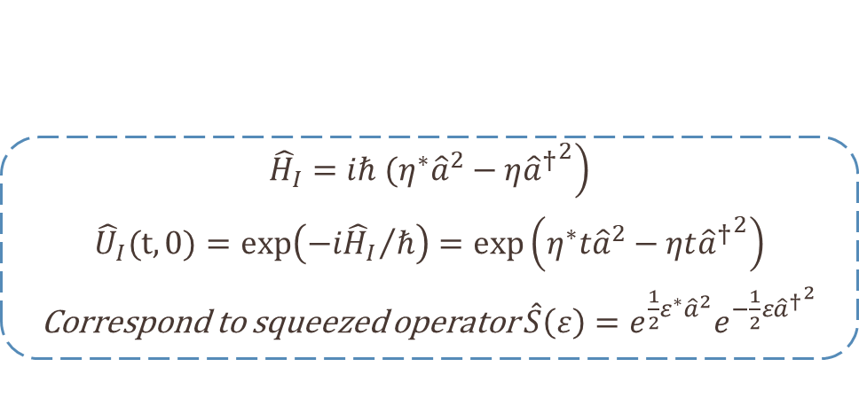





Sum frequency generation(SHG)/OPA
Conservation of Energy i.e. frequency-matching condition
Change the signal photon to vacuum
$$ω_{s}$$
$$ω_{s}$$
$$ω_{s}$$
$$ω_{p}$$
$$ω_{s}$$
$$ω_{s}$$
$$ω_{s}$$
$$ω_{s}$$
$$ω_{i}$$
$$χ^{\left(2\right)}$$
$$ω_{p}$$
$$χ^{\left(2\right)}$$
$$ω_{p}$$
$$χ^{\left(2\right)}$$
$$ω_{i}$$
$$ω_{i}$$
Up-conversion
Down-conversion
$$\left.{\hat{H}}_{I}=iℏ ({η^{∗}\hat{a}}^{2}−η{{\hat{a}}^{†}}^{2}\right)$$
$${\hat{U}}_{I}(t,0)=exp\left({−i{\hat{H}}_{I}}/ℏ\right)=exp\left({η^{∗}t\hat{a}}^{2}−ηt{{\hat{a}}^{†}}^{2}\right)$$
Correspond to squeezed operator $\hat{S}\left(ε\right)=e^{\frac{1}{2}ε^{∗}{\hat{a}}^{2}}e^{−\frac{1}{2}ε{{\hat{a}}^{†}}^{2}}$
C. Gerry and P. Knight, Introductory Quantum Optics. Cambridge University Press(2004)
Notes:
要產生非線性過程需要滿足能量守恆、動量守恆也就是相位匹配會在下一張投影片解釋
上轉換SHG
下轉換OPA
最後想產生真空壓縮態，可以將seed光類比成vacuum達到真空態轉成真空壓縮態

Slide 12

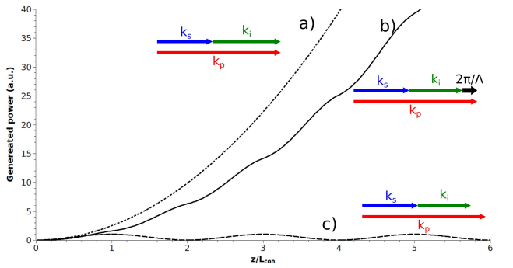
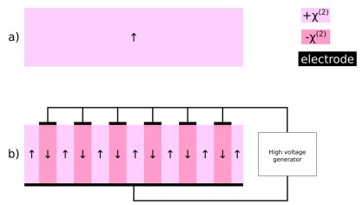
Quasi-phase matching(QPM)
Conservation of Momentum i.e. phase-matching condition
Use electric poling technology produce periodic inversion domain grating.
Compensated the phase mismatch in waveguides.
O. Alibart et al., "Quantum photonics at telecom wavelengths based on lithium niobate waveguides," Journal of Optics (United Kingdom), vol. 18, no. 10(2016)
Notes:
能夠外加電場讓晶疇反轉，達到相位補償，稱作準相位匹配如左圖
右圖是PPM QPM NPM

Slide 13
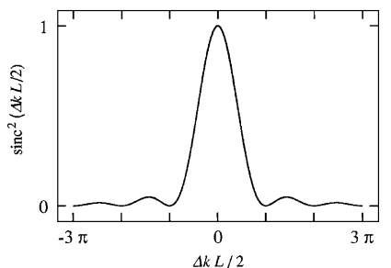
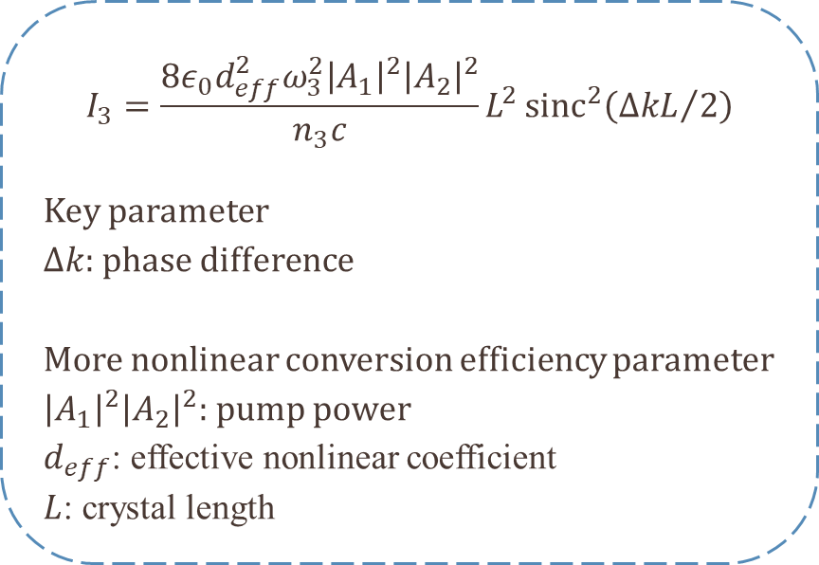
Phase-Matching condition
$$I_{3}={\frac{8ε_{0}d_{eff}^{2}ω_{3}^{2}{\left|A_{1}\right|}^{2}{\left|A_{2}\right|}^{2}}{n_{3}c}L}^{2}{sinc}^{2}\left({∆kL}/2\right)$$
Key parameter
$∆k$: phase difference
More nonlinear conversion efficiency parameter
${\left|A_{1}\right|}^{2}{\left|A_{2}\right|}^{2}$: pump power
$d_{eff}$: effective nonlinear coefficient
$L$: crystal length
R. W. Boyd, Nonlinear Optics, 4th Edition ed. Academic Press(2020)
Notes:
相位匹配在一般anisotropic晶體因為色散關係無法有相位匹配，本研究所使用的是LN晶體為負單軸雙折射晶體
在和頻實驗中，可以推導出右邊方程式，其中$∆k$正是影響著整個非線性轉換是否有效率
呼應前面提到的壓縮參數r和非線性轉換效率有關，在方程式中可以看到$A_{1}A_{2}$pump power、等效非線性係數以及晶體的長度，在相同波導結構中控制這三個參數能夠達到最高的轉換效率
左邊為和頻量測的實驗結果
本實驗為了有高非線性轉換效率，使用type-0拿到d33最高的非線性係數做轉換，也就是TM pump轉成TM signal+TM idler。

Slide 14
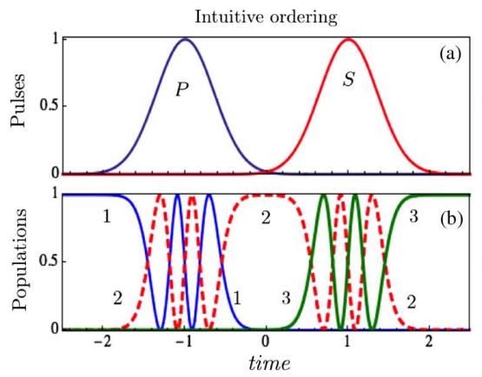
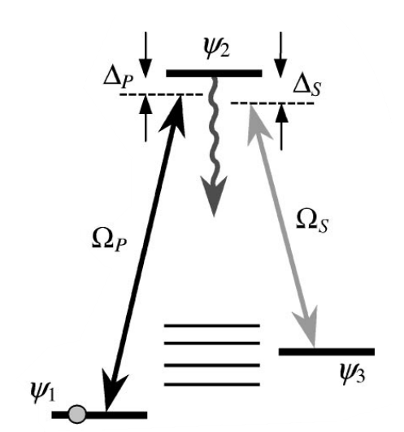
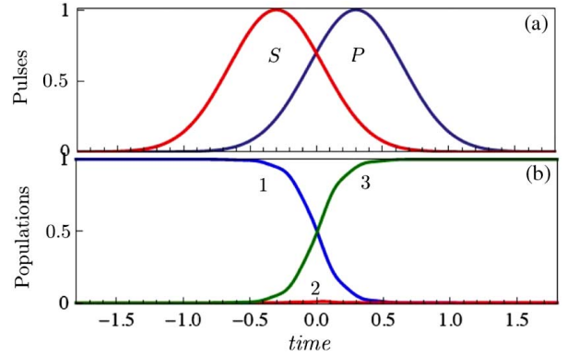
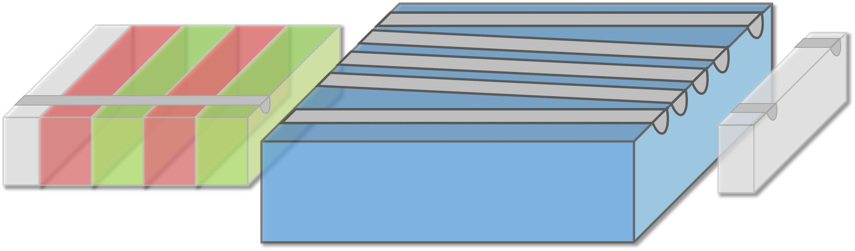
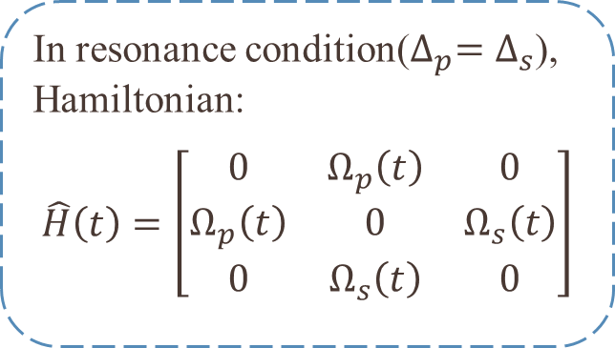
Stimulated Raman adiabatic passage (STIRAP)
Intuitive ordering
In resonance condition($∆_{p}=∆_{s}$),
Hamiltonian:
$$\hat{H}\left(t\right)=\left[\begin{matrix}0 & Ω_{p}\left(t\right) & 0 \\ Ω_{p}\left(t\right) & 0 & Ω_{s}\left(t\right) \\ 0 & Ω_{s}\left(t\right) & 0\end{matrix}\right]$$
Counter-intuitive ordering
T. H. Nikolay et al, "Laser-induced population transfer by adiabatic passage techniques," Annual Review of Physical Chemistry, vol. 52, no. 1, pp. 763-809(2001)
B. W. Shore, "Picturing stimulated Raman adiabatic passage: a STIRAP tutorial," Advances in Optics and Photonics, vol. 9, no. 3(2017)
Notes:
STIRAP是透過拉比共振和絕熱過程，利用兩者的優點，使粒子能夠產生了穩定的共振效應$∆_{p}=∆_{s}$，在共振系統中Hamiltonian描述如投影片中的矩陣
三能階系統 粒子數轉換 在時間上是先P再S是拉比共振過程
先P再S可以達到23能階先有相干疊加，後續S進來可以直接將粒子從1轉換3能階，當系統交互作用足夠緩慢，就不會激發2能階，稱作絕熱過程
此時時間上粒子分布和pulses是反直覺的過程

Slide 15
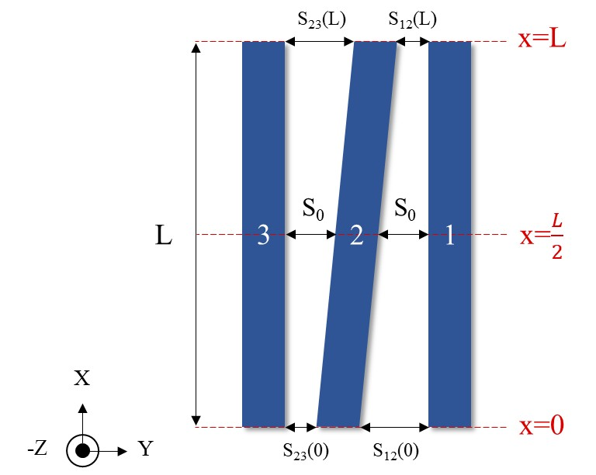
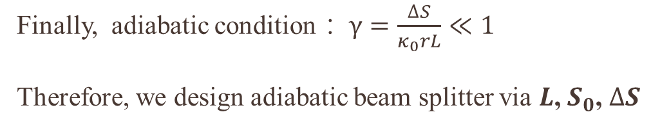
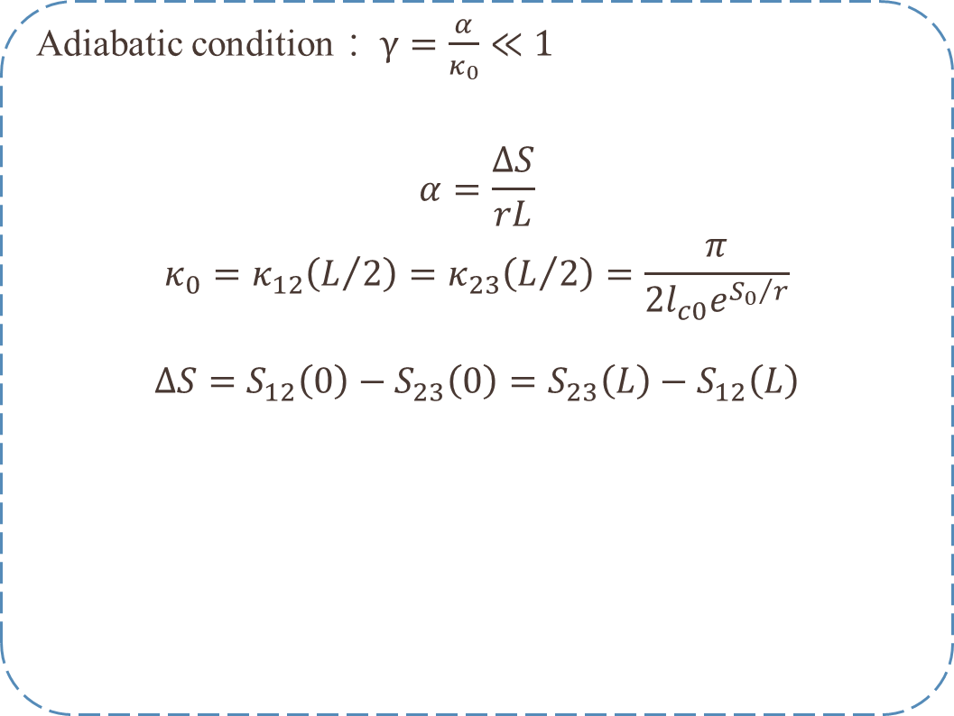
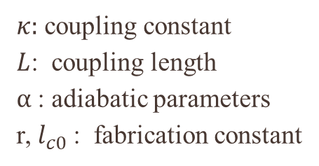
Stimulated Raman adiabatic passage (STIRAP)
Adiabatic condition： $γ=\frac{α}{κ_{0}}≪1$
$$α=\frac{∆S}{rL}$$
$$κ_{0}=κ_{12}\left(L/2\right)=κ_{23}\left(L/2\right)=\frac{π}{2l_{c0}e^{{S_{0}}/r}}$$
$$∆S=S_{12}\left(0\right)−S_{23}\left(0\right)=S_{23}\left(L\right)−S_{12}\left(L\right)$$
Finally, adiabatic condition： $γ=\frac{∆S}{κ_{0}rL}≪1$
Therefore, we design adiabatic beam splitter via $L$, $S_{0}$, $∆S$
$κ:$ coupling constant
$L$: coupling length
$α$: adiabatic parameters
r, $l_{c0}$: fabrication constant
H. P.Chung et al., "Adiabatic light transfer in titanium diffused lithium niobate waveguides," Optics Express, vol. 23, no. 24, p. 30641(2015)
Notes:
將拉比共振換成耦合係數、將時間域換成空間域，同樣在一個三能階系統中
絕熱性是否足夠可以透過絕熱條件$γ$來判斷
分子…
分母…
最後調整三個參數

Slide 16
Introduction
Theory
Simulation
Adiabatic beam splitter design
High-pass filter simulation
Fabrication process
Ti-indiffused waveguide
Electric field poling
End face polish
Experimental Results and Analysis
Propagation loss
ER spectrum
SHG characteristic
Squeezing light optical setup
Conclusion and future work

Slide 17
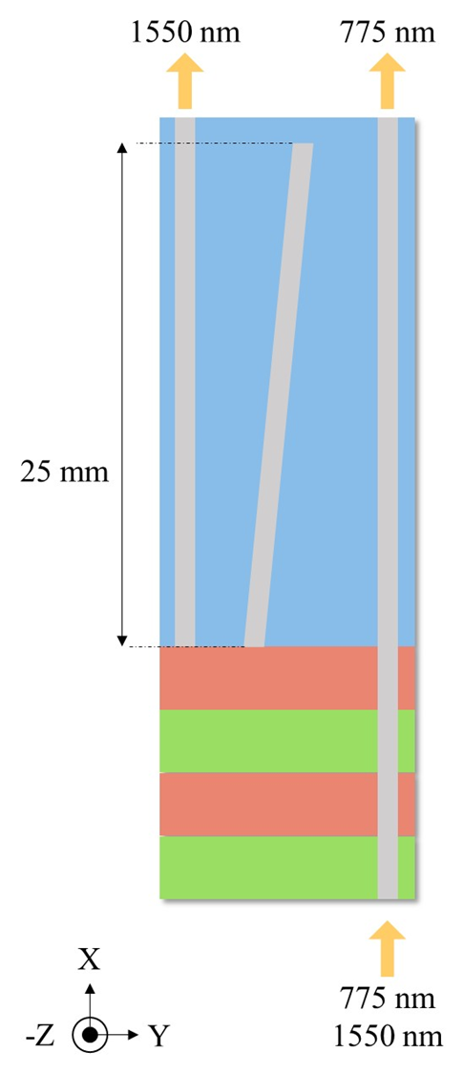
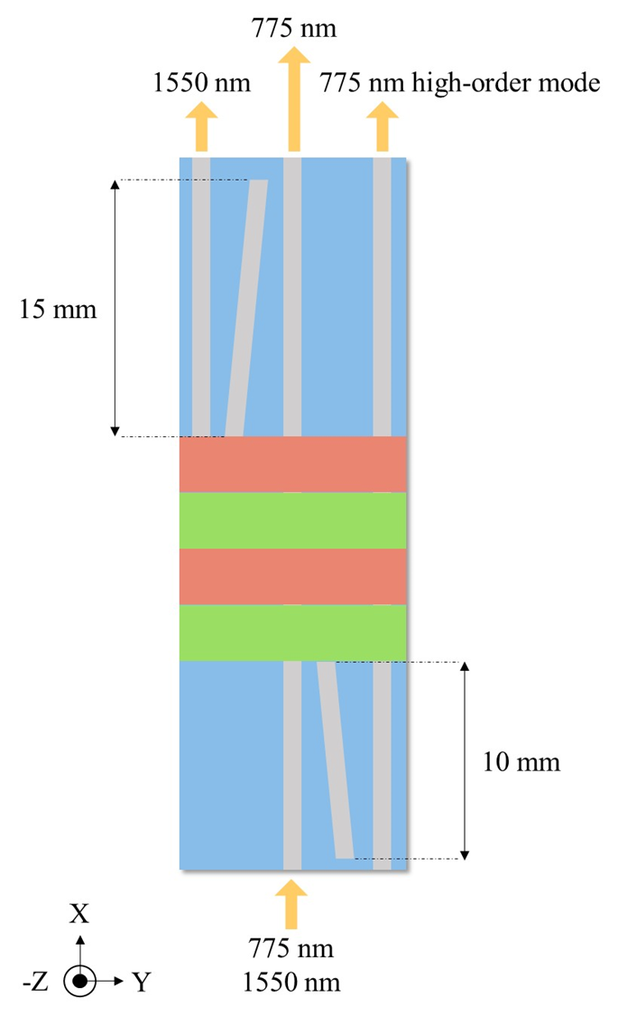
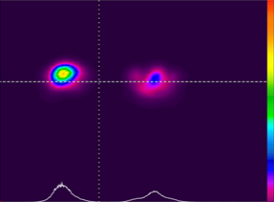
Adiabatic beam splitter design
Problems:
First version: use 785nm laser diode observe high-order mode at signal output.
Second version: design another adiabatic coupler to eliminate pump high-order mode at signal output. Due to fabrication limit, need to shorter coupling length cause adiabatically reduced. 1550nm has 5dB coupling efficiency as well as 76% power loss.
Finally, adopt five waveguides array to enhance the effective refractive index too close between pump and signal wavelength.
First version
Second version
pump port
signal port
Notes:
中間圖要改 775nm 775高模 右圖要改

Slide 18
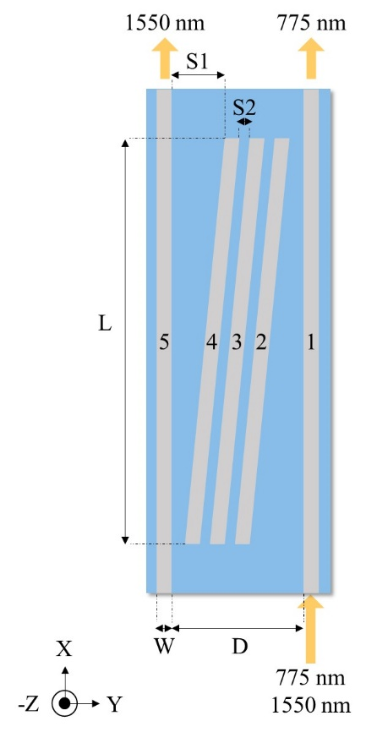
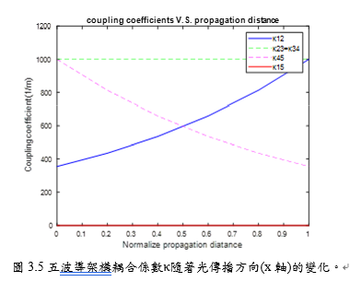
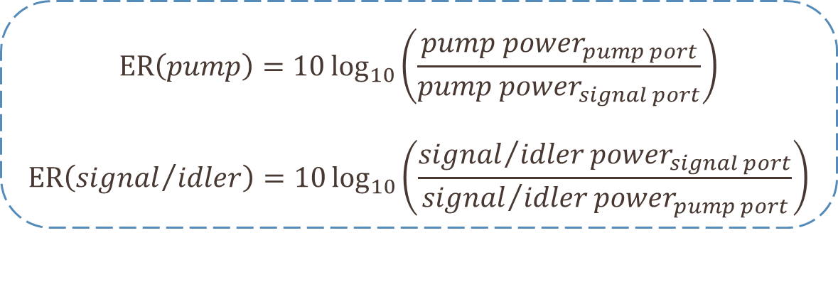

Adiabatic beam splitter design
$$ER\left(pump\right)=10\log_{10}\left(\frac{{pump power}_{pump port}}{{pump power}_{signal port}}\right)$$
$$ER\left({signal}/{idler}\right)=10\log_{10}\left(\frac{{{signal}/{idler}power}_{signal port}}{{{signal}/{idler}power}_{pump port}}\right)$$
adiabatic condition： $γ=\frac{∆S}{κ_{0}rL}≪1$

Slide 19
High-pass filter simulation
Notes:
1550ER

Slide 20
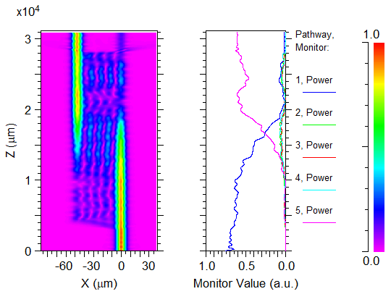
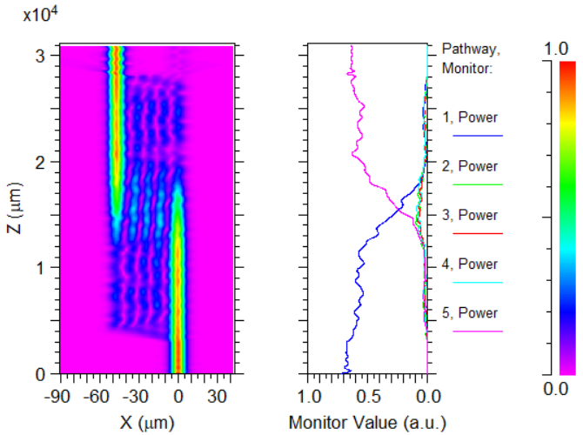
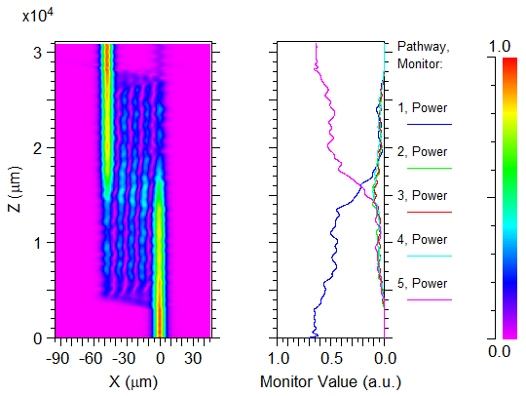
High-pass filter simulation BPM(signal)
(a)1500nm、(b)1550nm、(c)1600nm

Slide 21
High-pass filter simulation

Slide 22
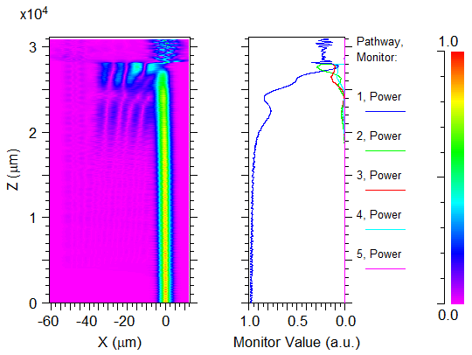
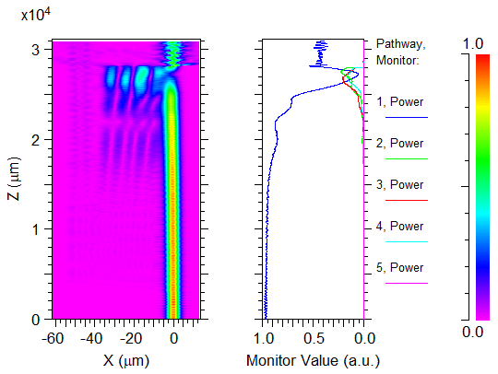
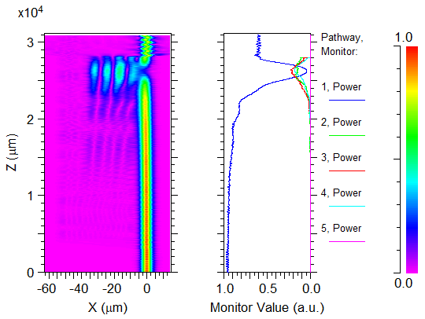
High-pass filter simulation BPM(pump)
(a)725nm、(b)775nm、(c)825nm

Slide 23
Introduction
Theory
Simulation
Fabrication process
Ti-indiffused waveguide
Electric field poling
End face polish
Experimental Results and Analysis
Propagation loss
ER spectrum
SHG characteristic
Squeezing light optical setup
Conclusion and future work
Notes:
首先製作Ti波導
在透過外加電場反轉晶疇 達到週期性結構
最後經過端面處理才能進入量測部分

Slide 24
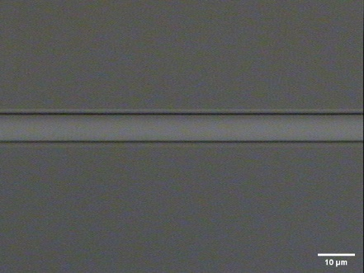
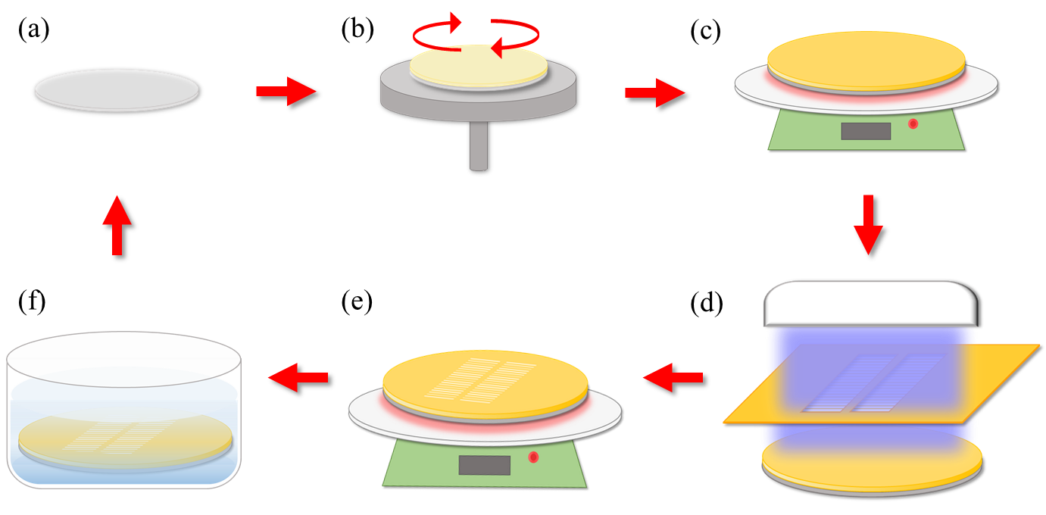
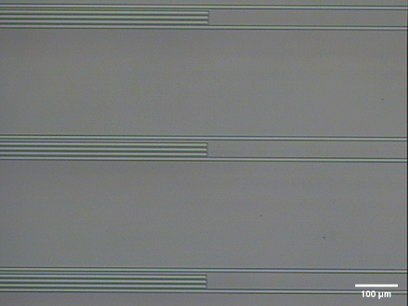
Ti-indiffused waveguide-lithography
Waveguides develop figures x10/x100

Slide 25
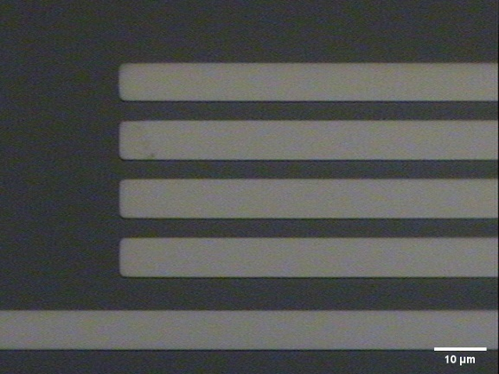
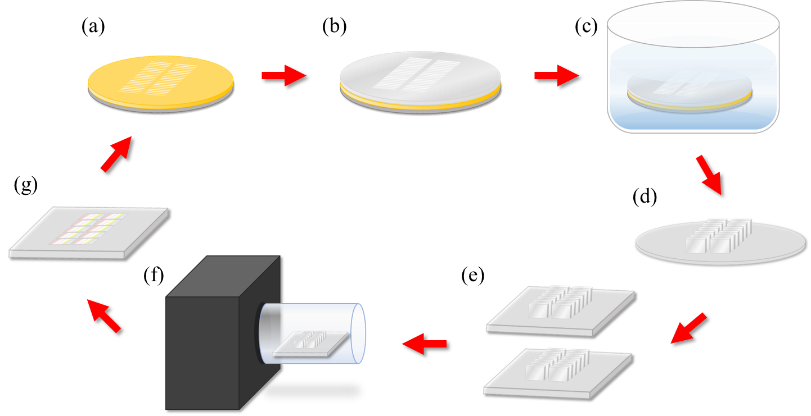
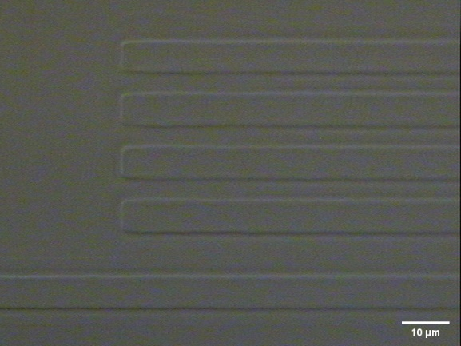
Ti-indiffused waveguide-diffusion
x100 waveguides lift-off/indiffused figures

Slide 26
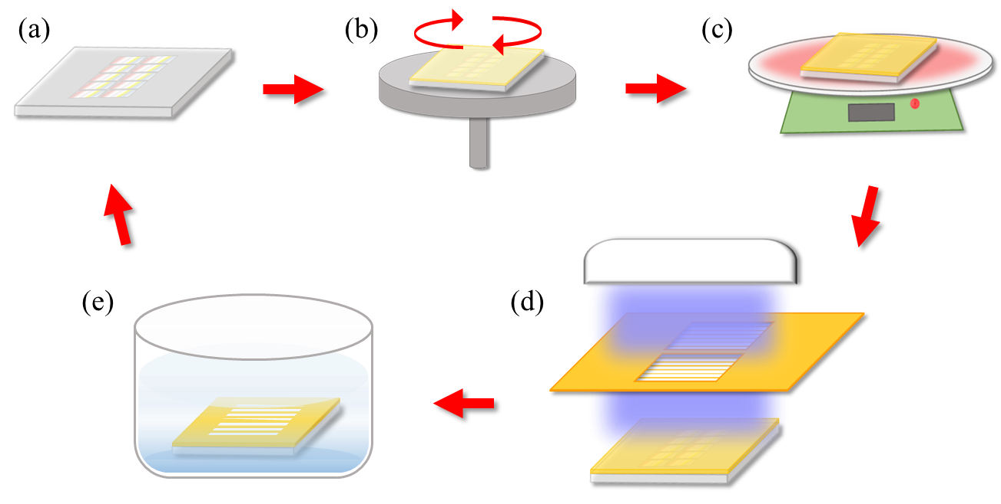
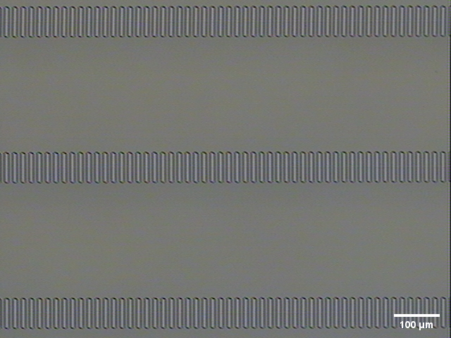
Electric field poling-lithography
Poling period develop figures x10

Slide 27
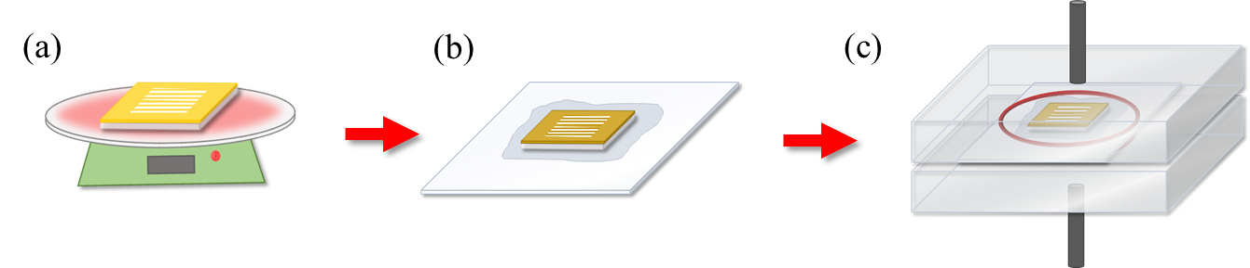


Electric field poling-poled
Poling period etch figures x10/x100

Slide 28





End face polish-chemical-mechanical polishing
Side view Chip both edges
LN
chip
LN
(a)
(b)
(c)

Slide 29
Introduction
Theory
Simulation
Fabrication process
Experimental Results and Analysis
Propagation loss
ER spectrum
SHG characteristic
Squeezing light optical setup
Conclusion and future work

Slide 30

Beam splitter scheme

Slide 31


Waveguide TM mode profile
1550nm
775nm

Slide 32


Waveguide TM mode profile
1540nm
1550nm
Extend the propagation distance for eliminate background noise

Slide 33


ER spectrum
Notes:
ER>10dB with 50nm

Slide 34

SHG scheme

Slide 35
SHG spectrum
在40℃下，不同週期的倍頻
在同週期17.21μm下，不同溫度的倍頻結果

Slide 36

Tuning rate
Estimate the tuning rate 0.134nm/$℃$

Slide 37



Squeezing light scheme

Slide 38

Real optical setup
Coherent light source
LO waveguide couple
Balance homodyne detection
Squeezed waveguide couple

Slide 39

Detail setup
LO waveguide coupling
squeezed waveguide coupling
BHD

Slide 40



Improve visibility
1550nm Waveguide mode profile(a)squeezed arm、(b)LO arm
Optimize mode match efficiency 1.65 times as well as observe squeezing level
fiber($η_{vis}\text{\sim 0.7}$) /waveguide mode($η_{vis}\text{\sim 0.9}$)

Slide 41

Spectrum analyzer
Different LO power correspond to shot noise

Slide 42

Improve 775nm coupling loss
775nm waveguide mode profile. Adjust the objective lens focal position to waveguide.
If (a) at Xmm、(b)at X+0.25mm
That is, 0.25mm range can’t deduce which position is the optimized.
Free space coupling efficiency~8.4dB

Slide 43


Improve 775nm coupling loss
Fiber coupling efficiency~4.8dB
Optimize pump coupling efficiency 2.29 times in waveguide

Slide 44


Calculation squeezing level
$$R_{±}=1−η+η×exp\left(±2\sqrt{aP}\right)$$
$$=1−η+η×exp\left(±2μ\sqrt{P}\right)$$
$R_{+}$ : Anti-squeezing level
$R_{−}$ : Squeezing level
$a$: SH conversion efficiency$\left(\%/{W^{−1}}\right)$
$μ$ : SH conversion efficiency root$\text{(}{mW}^{{−1}/2})$
$η$ : Total effective detection efficiency
r=$μ$*$\sqrt{P}$=$\sqrt{aP}$ $μ$= $\sqrt{\frac{P_{2ω}}{P_{ω}^{2}}}$
$a$= $\frac{P_{2ω}}{P_{ω}^{2}}∗$100 $a_{norm}$= $\frac{P_{2ω}}{P_{ω}^{2}L^{2}}∗$100
Use shot noise as a reference
Zhang, Mi, "Study of Spatial Structure of Squeezed Vacuum Field“, Dissertations(2016)
T. Kashiwazaki et al., "Continuous-wave 6-dB-squeezed light with 2.5-THz-bandwidth from single-mode PPLN waveguide," APL Photonics, vol. 5, no. 3, 2020

Slide 45


Calculation squeezing level
 | 2020[11] (PPLN) | 2020[53] (PPLN) | 2019[1] (PPLN+DC) | 2018[4] (PPLN+3*DC) | 2016[12] (PPLN) | Our estimate (PPLN)
Squeezing Level(dB) | -6.3 | -4 | -2 | -1.38 | -1.83 | -0.67
Waveguide type | Ridgeª | Ridge^{b} | SPE | RPE | Ridge^{c} | Ti
QPM length(mm) | 45 | 45 | 30 | 20 | 40 | 15
$a$_{norm}(%/W/cm²) | 57.28 |  |  | 92.5 | 125 | 15.8
$μ({mW}^{{−1}/2}$) | 0.108 |  |  | 0.061 | 0.141 | 0.019
$μ$ fitting(${mW}^{{−1}/2}$) | 0.11 | 0.101 |  | 0.03 | 0.101
$η$ estimate |  | 0.62 | 0.71 |  | 0.65 | 0.67
$η$ fitting | 0.79 | 0.61 |  | 0.52 | 0.54
$a$: SH conversion efficiency$\left(\%/{W^{−1}}\right)$
$μ$ : SH conversion efficiency root$\text{(}{mW}^{{−1}/2})$
$η$ : Total effective detection efficiency
ªZnO:LN bonded onto LiTaO₃ ^{b}LN bonded onto LiTaO₃ ^{c}LN etching
SPE=soft-proton exchange RPE=reverse proton exchange
Different waveguide type and longer QPM length provide more nonlinear conversion efficiency
Ti-indiffused waveguide efficiency almost RPE waveguide 0.17 times
Notes:
再量測壓縮光可以分為兩個部分討論 第一種是晶片的非線性的轉換效率 其次是光路的偵測效率
這個表格主要是討論我們所設計的晶片所使用的波導材料以及具備的轉換效率 和其他文獻的差別 可以看到他們所使用的QPM長度大多是我們兩倍的長度，使用的材料效率最差的是SPE的波導 效率比鈦高

Slide 46


Calculation squeezing level
Our measurement:
SH conversion efficiency 0.019${(mW}^{{−1}/2}$)
η = 0.67
Estimate squeezing level at pump power = 40mW
Longer QPM length get more squeezing level
η = ηF · ηf · ηPD ·ηe · ${ηvis}^{2}$
Efficiency factor | parameter | value
LN-air interface | ηF | 0.86
Free space transmission | ηf | 0.985
PD quantum efficiency | ηPD | 0.995
PD electronic noise | ηe | 0.98
Mode match(visibility) | ηvis | 0.9
Total detection efficiency | η | 0.67
QPM length(mm) | 15 | 30 | 38 | 45
Squeezing Level (dB) | -0.67 | -1.28 | -1.58 | -1.83
Notes:
所計算的方式是使用

Slide 47
Introduction
Theory
Simulation
Fabrication process
Experimental Results and Analysis
Conclusion and future work

Slide 48

Conclusion
We demonstrated :
Successfully fabricated the periodically poled lithium niobite(PPLN) cascaded adiabatic beam splitter on chip.
PPLN normalize second harmonic generation efficiency 15.8%/W/cm² with 15mm QPM length.
Adiabatic coupler as beam splitter which the characteristic ER>10dB with 68nm bandwidth, ER>20dB with 18nm bandwidth and coupling ratio up to 99.5% at 1550nm.
Optimized on-chip squeezer measurement setup, including 775nm pump wavelength coupling efficiency in waveguide, mode matching.
775nm coupling efficiency improved by fiber coupling, from -8.5dB to-4.8dB.
Mode matching via fiber mode($η_{vis}\text{\sim 0.7}$) replaced by waveguide mode($η_{vis}\text{=0.8\sim 0.9}$).

Slide 49
Future work
On-chip squeezer enhance:
The adiabatic beam splitter component require longer coupling length. That is, reducing nonlinear conversion efficiency so that limit the squeezing level.
Longer QPM length.
Change waveguide type.
Squeezing setup stabilize:
Achromatic objective lens
Chip oven temperature control system
Notes:
先不使用AC做分光 先將QPM長度拉長提高非線性效率
希望整合更多元件就會建議採用其他種類的波導
架構已經完整了，可以加消色差物鏡耦合方式、設計更為穩定的溫控器，使得量測系統更加完善穩定

Slide 50
Thank you for listening !

Slide 51

Photorefractive effect
本論文選擇此溫度為操作溫度的原因是為了消除光折變效應(photorefractive effect)，其原理為當一強光集中於特定區域，像是本論文中的波導結構時，會激發出晶體中的電子，但此電子會被侷限住形成不均勻的電場，此電場會因為晶體本身是鐵電性晶體的關係而造成折射率的改變，影響到原本計算出來的非週期性晶疇極化反轉結構，降低非線性轉換的效率，當溫度越高時，電子變越不容易被侷限在特定區域，如此便可以減低光折變效應所帶來的影響。
Gain-induced diffraction
在high gain狀況下，signal容易被pump影響，會讓squeezed beam產生相位的破壞，且空間上不會合LO beam match，所以LO無法準確的偵測squeezed quadrature
$μ$正比L
$a$正比$L^{2}$

Slide 52
High-pass filter simulation

Slide 53
High-pass filter simulation

Slide 54

Propagation loss scheme

Slide 55



Propagation loss
鈦擴散波導(左)TM偏振傳播損耗、 (右)TE偏振傳播損耗
$α_{TM}=0.2008dB/cm$，$α_{TE}=0.3503dB/cm$

Slide 56
ER spectrum
Notes:
ER>10dB with 50nm

Slide 57


Calculation squeezing level
 | 2020[11] (PPLN) | 2020[53] (PPLN) | 2019[1] (PPLN+DC) | 2018[4] (PPLN+3*DC) | 2016[12] (PPLN) | Our estimate (PPLN)
Squeezing Level(dB) | -6.3 | -4 | -2 | -1.38 | -1.83 | -0.67
Waveguide type | Ridgeª | Ridge^{b} | SPE | RPE | Ridge^{c} | Ti
QPM length(mm) | 45 | 45 | 30 | 20 | 40 | 15
$a$_{norm}(%/W/cm²) | 57.28 |  |  | 92.5 | 125 | 15.8
$μ({mW}^{{−1}/2}$) | 0.108 |  |  | 0.061 | 0.141 | 0.019
$μ$ fitting(${mW}^{{−1}/2}$) | 0.11 | 0.101 |  | 0.03 | 0.101
$η$ estimate |  | 0.62 | 0.71 |  | 0.65 | 0.67
$η$ fitting | 0.79 | 0.61 |  | 0.52 | 0.54
SPDC conversion efficiencies (pairs/mW/GHz/s) |  |  | ~10⁵ |  | ∼1.2 · 10⁶
Propagation loss(dB∕cm) |  |  | 0.04 | 0.14 | 0.4 | 0.2
SH conversion efficiency :$a$(%/$W^{−1}$), Normalize $a_{norm}$ (%/$W^{−1}$/ cm²)
SH conversion efficiency root : $μ\text{(}{mW}^{{−1}/2})$
Total effective detection efficiency : $η$
ªZnO:LN bonded onto LiTaO₃ ^{b}LN bonded onto LiTaO₃ ^{c}LN etching
SPE=soft-proton exchange RPE=reverse proton exchange
Notes:
再量測壓縮光可以分為兩個部分討論 第一種是晶片的非線性的轉換效率 其次是光路的偵測效率
這個表格主要是討論我們所設計的晶片所使用的波導材料以及具備的轉換效率 和其他文獻的差別 可以看到他們所使用的QPM長度大多是我們兩倍的長度，使用的材料效率最差的是SPE的波導 效率比鈦高

